Slide 1

Opioid Use Disorder in the Emergency Department
Bridging the Gap: Clinical Theory, Edge Cases, and Simulated Practice
Bryan English, MD
Department of Emergency Medicine · Stony Brook University

Slide 2
Learning Objectives
By the end of this session, you will be able to:
1
Recognize OUD
Identify opioid use disorder using a pattern-based approach to DSM-5 criteria in the ED setting
2
Assess Readiness
Evaluate withdrawal status and apply the pre-induction checklist to determine timing for buprenorphine initiation
3
Initiate Buprenorphine
Execute standard and rapid induction protocols, including fentanyl-involved cases
4
Manage Complications
Differentiate undertreated from precipitated withdrawal and apply the 90-minute red zone bundle
5
Plan Disposition
Develop a maintenance and discharge plan addressing complicating factors and ensuring continuity of care

Slide 3
The Emergency Department Reality
Why Start in the ED?
>80,000 Overdose Deaths (2023): Fentanyl drives the crisis.
Buprenorphine initiation is incredibly high-yield:
ED Volume: 2-3% of all ER visits involve opioids, and 18-25% involve alcohol. SUD is massively underdiagnosed.
2
3
Treatment Gap: Only 19% of patients with OUD receive medication.
Number Needed to Treat (NNT) to retain in treatment
Number Needed to Treat (NNT) to stop illicit drug use

Slide 4








OUD Diagnosis (DSM-5 Criteria)
Heuristic: You don't need all 11 criteria memorized—recognize the clinical pattern. (≥2 criteria in 12 months = OUD).
Impaired Control
Social Impairment
Risky Use
Pharmacologic
Continued use in physically hazardous situations despite consequences.
Tolerance (needing more) and Withdrawal (symptoms when stopping).
Using more/longer than intended, or failed attempts to cut down.
Failure to fulfill major role obligations, or giving up important activities.

Slide 5
What is Buprenorphine?
A partial opioid agonist that is the cornerstone of medication-assisted treatment for OUD
Partial Agonist
Why It Matters in the ED
Binds mu-opioid receptors with high affinity but only partial activation — relieves withdrawal and cravings without full euphoria
✓
Safe to initiate in the ED — ceiling effect means low overdose risk even with imprecise dosing
Ceiling Effect
✓
High receptor affinity displaces other opioids, which is therapeutic but can precipitate withdrawal if timed incorrectly
Respiratory depression plateaus at moderate doses, making overdose far less likely than with full agonists like methadone or fentanyl
✓
Naloxone component deters IV misuse but is clinically inactive when taken sublingually
Sublingual Formulations
✓
X-waiver eliminated (Jan 2023) — any provider with a DEA license can prescribe
Administered as SL tablet or film (Suboxone = buprenorphine + naloxone). No special DEA waiver required since 2023
Next: How buprenorphine compares to methadone

Slide 6


Buprenorphine vs. Methadone
Buprenorphine (Partial Agonist)
Methadone (Full Agonist)
High Affinity: Outcompetes nearly all other opioids at the receptor.
No Ceiling Effect: Linear dose-response increases the risk of respiratory depression and overdose.
Ceiling Effect: Activation plateaus at 40-50%, providing a massive safety margin against respiratory depression.
Highly Regulated: Cannot be prescribed from the ED for OUD.
Blockade Effect: Pharmacological shield against illicit full agonists.
Requires specialized Opioid Treatment Program (OTP) enrollment for daily dosing.
Can be initiated and directly prescribed from the ED.

Slide 7
Assessment & Pre-Induction
Understanding Pathophysiology and Clinical Assessment

Slide 8
Recognizing Withdrawal & Expected Timelines
What It Looks Like (The "Crash")
Practical Withdrawal Windows
Unoccupied receptors put the body into massive overdrive.
Short-Acting (Heroin, Oxycodone): Onset starts in 8–24 hours | Peaks at 36–72 hours.
Physical Distress: Racing heart, high BP, sweating, goosebumps, vomiting, diarrhea.
Long-Acting (Methadone): Onset starts in 36–48 hours | Peaks at 72–96 hours.
Mental Distress: Severe anxiety, dysphoria, anhedonia, intense cravings.
The Fentanyl Wildcard: Highly lipophilic. Timeline is completely unpredictable. Onset can be delayed up to 24+ hours.

Slide 9





Clinical Assessment: Pre-Induction Checklist
1. COWS Score
2. Objective Signs
3. Patient Consent
Must be ≥ 8 (ideally > 12) to avoid precipitated withdrawal. Must reassess COWS prior to each dose.
Subjective pain is not enough. Must have at least 2 objective signs (e.g., pupil dilation, yawning, diaphoresis, piloerection, tachycardia).
Patient must understand the induction process, the risks of precipitated withdrawal, and commit to the clinical protocol.

Slide 10
COWS Score Reference
Clinical Opiate Withdrawal Scale — the objective tool that guides induction timing
5–8
Mild
Clinical Pearls
Lacrimation, rhinorrhea, mild anxiety, yawning
→ Monitor — not yet ready for induction
●
Score >12 is the traditional induction threshold — but clinical judgment matters more than any single number
9–12
Moderate
Dilated pupils, piloerection, restlessness, muscle aches
●
With fentanyl, patients may score high on COWS yet still have depot opioid on board — precipitated withdrawal risk persists
→ Approaching threshold — prepare for induction
13–24
Moderate–Severe
●
Reassess every 30–60 min during the observation period; a rising score confirms progressive withdrawal
GI distress, tremor, diaphoresis, elevated vitals
→ Induction threshold — proceed with dosing
●
COWS is not validated for neonates or sedated patients — use alternate tools (e.g., Finnegan for neonates)
25–48
Severe
Fever, emesis, diarrhea, tachycardia, severe distress
→ Urgent — initiate buprenorphine immediately
Wesson DR, Ling W. Clinical Opiate Withdrawal Scale (COWS). J Psychoactive Drugs. 2003;35(2):253–259.

Slide 11




Complicating Factors (Modify or Delay)
Methadone Maintenance
Severe Acute Pain / Trauma
Wait ≥ 48-72 hrs. Consider alternative medical management or specific micro-induction protocols. High risk of prolonged precipitated withdrawal.
Buprenorphine treats pain, but major trauma may require full agonists to override. Requires careful co-management with surgery/anesthesia.
Altered Mental Status
Pregnancy
High risk for synergistic respiratory depression with alcohol/benzos/xylazine. Delay induction until clinically sober.
Never withhold treatment. Untreated OUD is vastly more dangerous than neonatal withdrawal syndrome. Use Buprenorphine monoproduct.

Slide 12
Buprenorphine
Induction, Maintenance & Transition Protocol
Clinical guidance for initiating, optimizing, and transitioning patients on buprenorphine therapy

Slide 13


Buprenorphine Induction
Goal: Achieve 16 mg total within the first day.
Wait for moderate to severe withdrawal before beginning pathway:
Rapid Induction (ED/ICU Pathway)
Standard Induction (General Pathway)
For medically supervised settings with close monitoring.
For most non-critical care patients.
First Dose: 8 mg Buprenorphine SL.
First Dose: 4 mg Buprenorphine SL.
Reassess: Wait 60 minutes, re-evaluate COWS.
Reassess: Wait 60 minutes, re-evaluate COWS.
Subsequent Doses: 8 mg SL PRN until significant relief (COWS ≤ 4).
Subsequent Doses: 4 mg SL PRN until significant relief.

Slide 14
Buprenorphine Maintenance
Goal: Continue at least 16 mg buprenorphine for maintenance of therapy.
Choose one daily maintenance regimen by matching induction versus home dosing:
8 mg
16 mg
24 mg
32 mg
Sublingual, BID
Sublingual, Daily
Sublingual, Daily
Sublingual, Daily
Twice daily — split dosing
Standard maintenance dose
Higher opioid dependence
Severe opioid dependence
For patients already on buprenorphine: Confirm their current dose and continue as the maintenance dose.

Slide 15
Buprenorphine Discharge & Linkage
Goal: Ensure a smooth transition to outpatient care and sustained recovery.
Provide a 2-week buprenorphine supply at the stabilized dose, naloxone for safety, and link to ongoing care.
Discharge Prescription
Naloxone Prescription
Linkage to Community Care
8 mg/day
Naloxone 4 mg Nasal Spray
01
Primary Care Physician
Suboxone (buprenorphine/naloxone) 8 mg/2 mg SL Film
Dispense: #2 (or 1 kit of 2 pre-filled syringes)
Establish or resume relationship with a PCP for ongoing medical management.
Take 1 film sublingual once daily · #14
Sig: Use as directed for opioid overdose
16 mg/day
Refills: As needed
Suboxone (buprenorphine/naloxone) 8 mg/2 mg SL Film
02
Outpatient Addiction Provider
Take 2 films sublingual once daily · #28
Why naloxone at discharge?
Refer to an outpatient addiction treatment program or MAT clinic.
24 mg/day
• Protects against accidental overdose during dose adjustment
• Essential safety net during transition to outpatient care
Suboxone (buprenorphine/naloxone) 8 mg/2 mg SL Film
Take 3 films sublingual once daily · #42
03
Peer Support & Recovery
32 mg/day
Narcotics Anonymous (NA), SMART Recovery, or community-based peer support groups.
Suboxone (buprenorphine/naloxone) 8 mg/2 mg SL Film
Take 4 films sublingual once daily · #56
★ 2-week supply at stabilized dose
★ Discharge Rx required before patient leaves
★ Connect before discharge — warm handoff preferred
Notes:
Address Objections: "This is enabling" → It reduces mortality by >50%. We don't withhold insulin for diabetes.

Slide 16
Special Considerations
Fentanyl Users · Methadone · Post-Naloxone · Precipitated Withdrawal

Slide 17
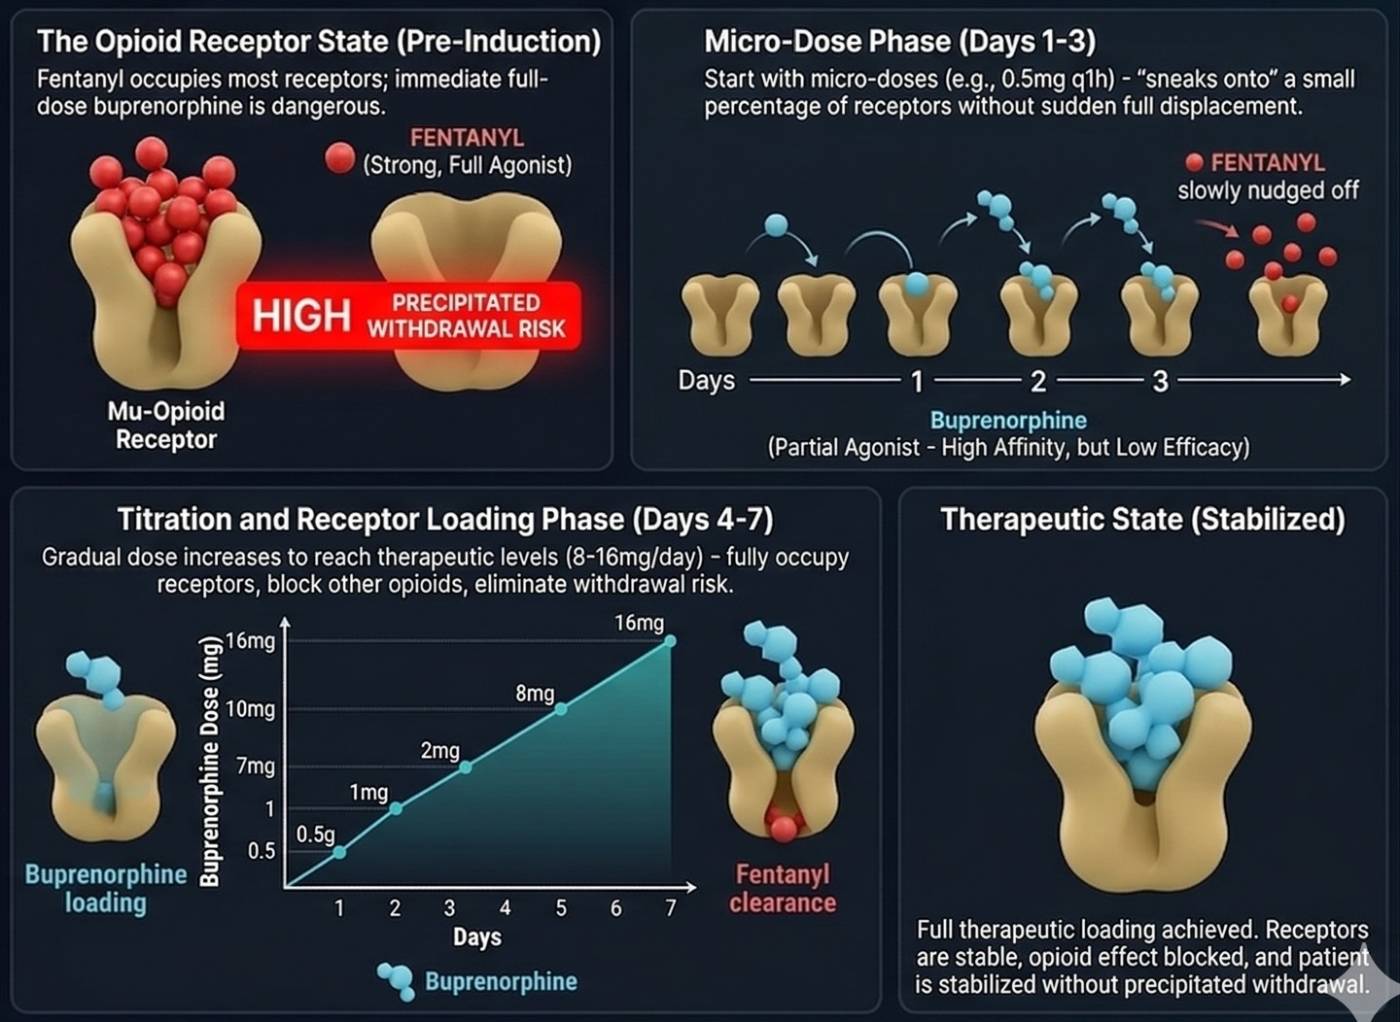
Low-Dose (Bernese) Protocol
When Standard Induction Is Unsafe
Use when standard induction poses a high risk of precipitated withdrawal — fentanyl, methadone, or high-dose opioid pain patients.
Indications: Fentanyl-positive UDS; active methadone use; high-dose opioid patients requiring a controlled taper.
Low-Dose Strategy: Start with very small doses (0.5–2 mg) while the patient is still on a full agonist, avoiding abrupt receptor displacement.
Titration: Titrate up over 1–3 days to 8–16 mg/day as buprenorphine gradually displaces the full agonist.

Slide 18
Post-Naloxone Buprenorphine Strategy
Strategy: Administer 16 mg buprenorphine to establish receptor blockade before short-acting naloxone wears off.
Phase 2: Naloxone Reversal
Naloxone abruptly strips Fentanyl. Receptors empty. Acute withdrawal begins.
Phase 1: Overdose
Phase 3: Bup Admin
Fentanyl floods the μ-receptors. Patient becomes apneic.
16mg Buprenorphine replaces Naloxone before Fentanyl can return and re-sedate.

Slide 19


Precipitated Withdrawal: Recognition
Undertreated Withdrawal
Precipitated Withdrawal
Dose was insufficient to saturate receptors.
Buprenorphine forcefully displaced a full agonist.
Timing: Gradual lack of improvement (45-60 mins).
Timing: Abrupt, violent onset (10-15 mins).
Symptoms: Exploding COWS score, severe agitation, N/V.
Symptoms: Persistent baseline COWS symptoms.
Action: Trigger 90-Minute Bundle.
Action: Give more Buprenorphine.

Slide 20



The 90-Minute Red Zone Bundle
Time Zero
30 Mins (Reassess)
60-90 Mins
16 mg Buprenorphine SL + 2 mg Lorazepam PO/IV
If worsening, give another 16 mg Buprenorphine SL.
Do not stack benzos. Use additional Bup, Ketamine, or Haloperidol.
KEY RULE: DO NOT STOP BUPRENORPHINE. The fastest way out is through. Flood the receptors to maximize the partial agonist effect.
Expert Support: Consult Toxicology, Psychiatry, or Addiction Medicine for assistance with refractory symptoms.

Slide 21
Clinical Summary
Five things to take with you from the didactic portion
1
Buprenorphine is safe to start in the ED
Partial agonist with a ceiling effect. Any DEA-licensed provider can prescribe — the X-waiver is gone.
2
Use COWS >12 as a guide, not gospel
Fentanyl’s lipophilicity means depot stores can persist even at high COWS scores. Clinical judgment leads.
3
Standard vs. rapid induction — know both pathways
Standard: 4 mg SL, then 4 mg PRN q1h. Rapid (ED/ICU): 8 mg SL, then 8 mg PRN until COWS ≤ 4. Titrate to comfort.
4
Precipitated withdrawal is treatable, not catastrophic
Abrupt onset in 10–15 min with exploding COWS. Trigger the 90-minute bundle: give more buprenorphine, not less.
5
Discharge with a 2-week supply and community linkage
Prescribe 16 mg daily × 14 days (28 films). Always co-prescribe naloxone. Link to PCP and outpatient addiction treatment.

Slide 22






Final Heuristics
The ED is the Point
Respect the Receptor
Push Through PW
The Emergency Department is the definitive intervention point, not a holding area.
Wait for objective withdrawal (COWS > 12 + 2 signs).
Dose with confidence (8mg, reassess, 8mg). If PW occurs, escalate Buprenorphine.
We know the rules. But are we comfortable executing them?

Slide 23
From Protocol to Practice
Didactic learning ≠ real-world skill.
The True Barriers: We under-screen due to time constraints, workflow issues, and simply feeling awkward initiating the conversation.
High-Stakes Fear: Fear of precipitated withdrawal is a massive barrier with no easy way to practice.
What if you could practice induction before they walk through the door?
Notes:
<30% EM physician feel comfortable with initiating buprenorphine induction due to fee of precipitated withdrawal

Slide 24

Introduction to BupSim
Meet Maria Torres, 32F
Brought in by EMS after a naloxone-reversed oxycodone overdose.
Virtual Simulation: A web-based, AI-driven virtual patient simulator.
Mobile-Optimized: A touch & voice-enabled webapp — runs on iPad, iPhone, and desktop.
End-to-End Care: BupSim guides you through her full buprenorphine induction case from ED arrival to discharge.

Slide 25
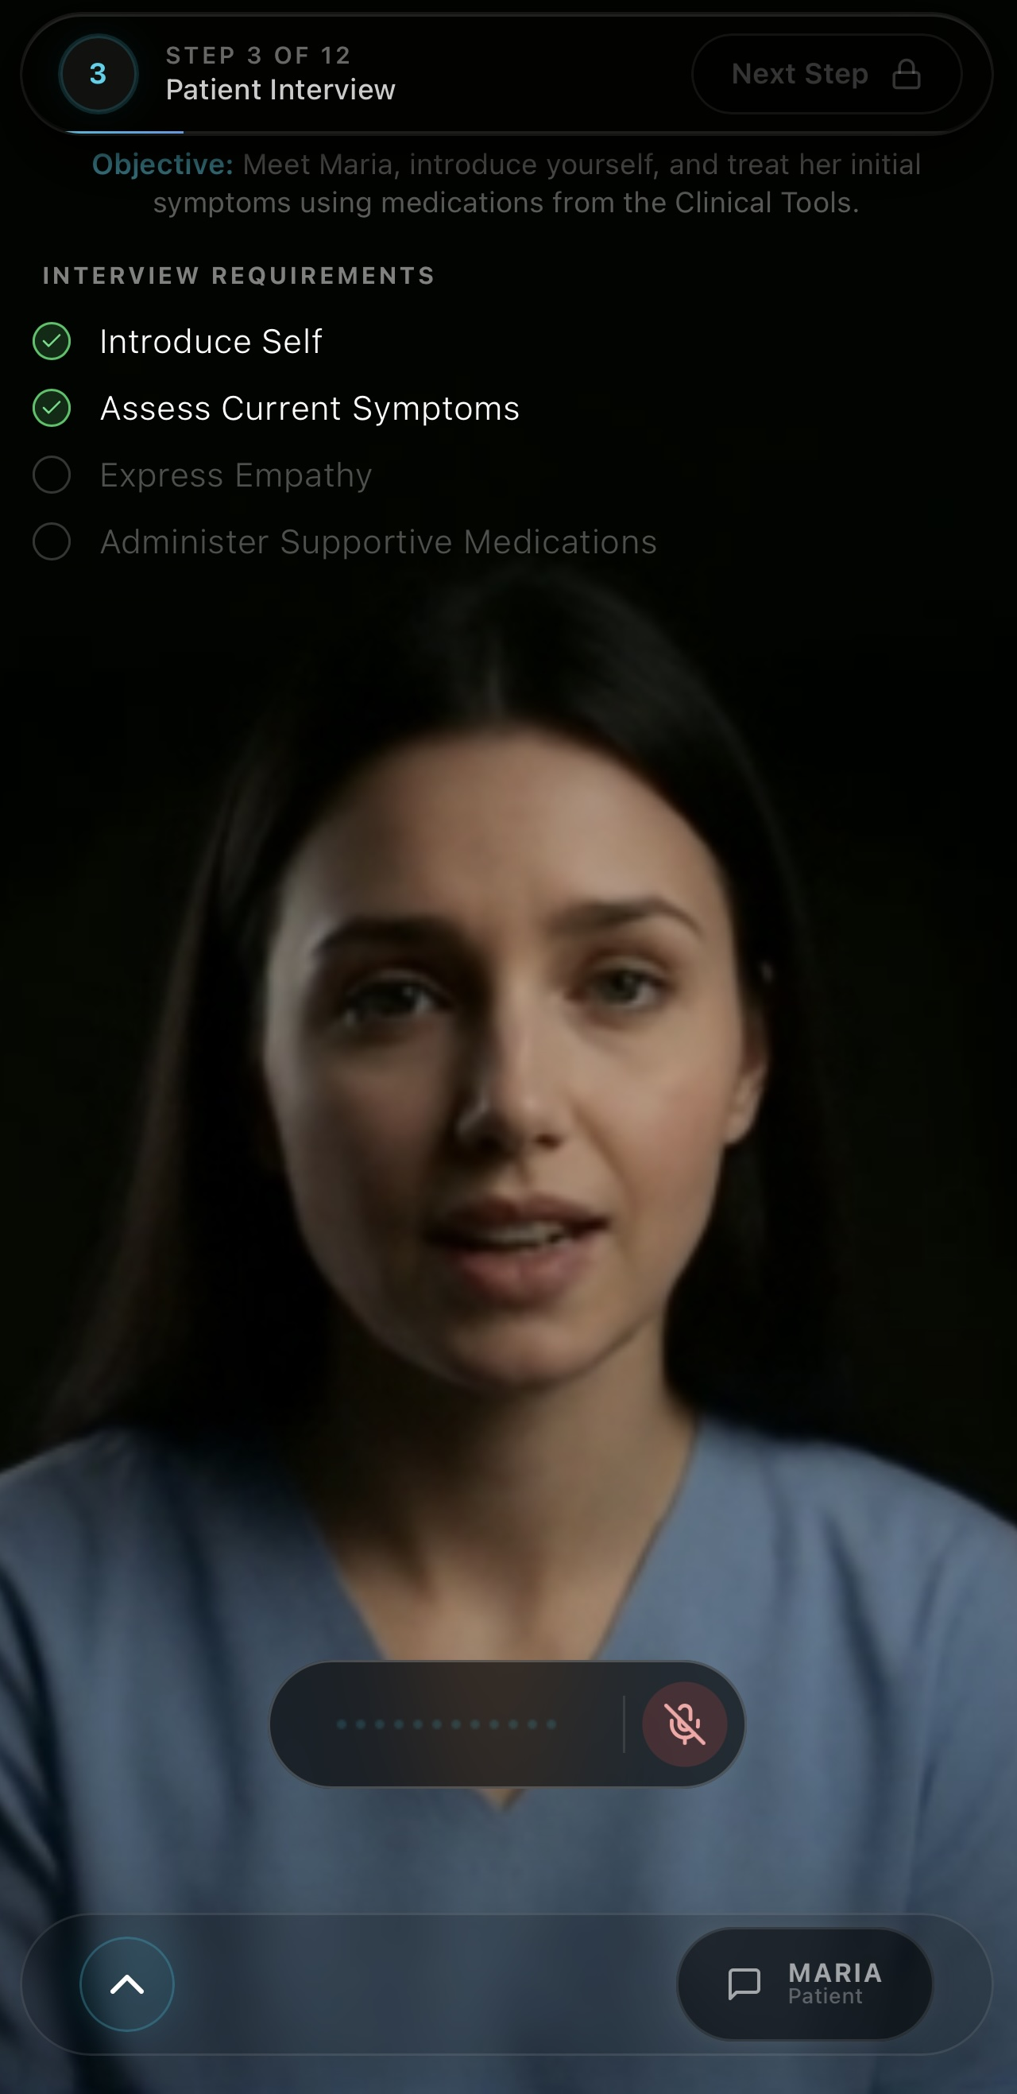
Conversing with Maria
Practice the Conversation
Powered by AI: Google Gemini Live drives natural voice responses with real-time lip sync.
Real Empathy: Maria responds to your tone, pacing, and clinical actions throughout.
Real Fears: She asks the hard questions — "Will this make me sick?"
Builds Rapport: Guarded at first, opens up through active listening.
Medication-Responsive: Anxiety eases when dosing and explanation are correct.
Clinical Assistant: AI guide answers questions and coaches you through the case.

Slide 26

Clinical Interface
The HUD displays your current step and clear clinical objectives.
Clinical Tool Bar:
COWS Assessment: Scale for opioid withdrawal
Quick Orders: Labs, meds, and imaging
Results: Imaging and lab reports
Discharge Plan: Rx & follow-up
Clinical Guardrails: The simulator enforces real-world safety rules. Steps remain locked until critical actions are completed, preventing premature interventions.

Slide 27
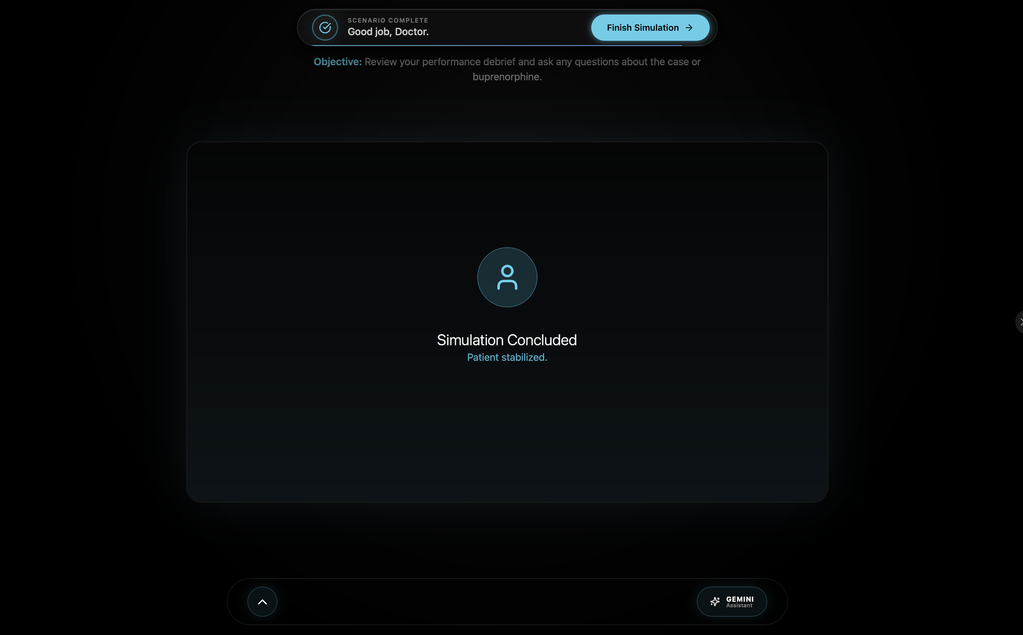
Personalized Debrief

Slide 28





CPMP Risk Mitigation Grant: Analytics
Buprenorphine Utilization
Confidence Scoring
Risk Reduction Goals
Tracks the number of buprenorphine inductions performed in the ED before and after training to measure real-world clinical impact.
Pre & post-training Likert scale measures self-reported confidence in initiating buprenorphine induction.
By increasing physician confidence and buprenorphine utilization, we aim to reduce post-discharge relapse, opioid-related overdose, and the downstream complications of undertreated withdrawal.

Slide 29
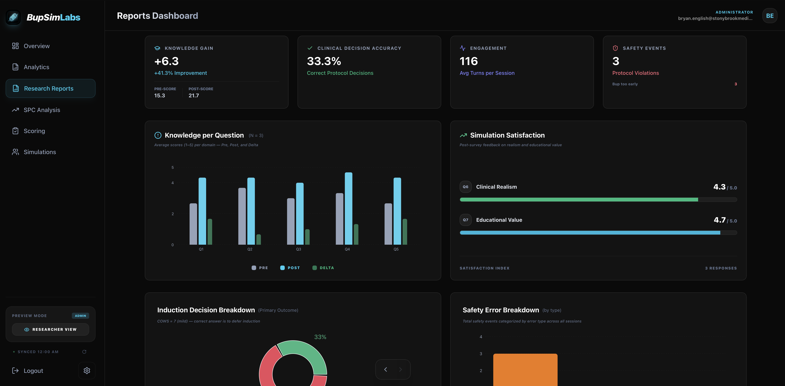

Slide 30
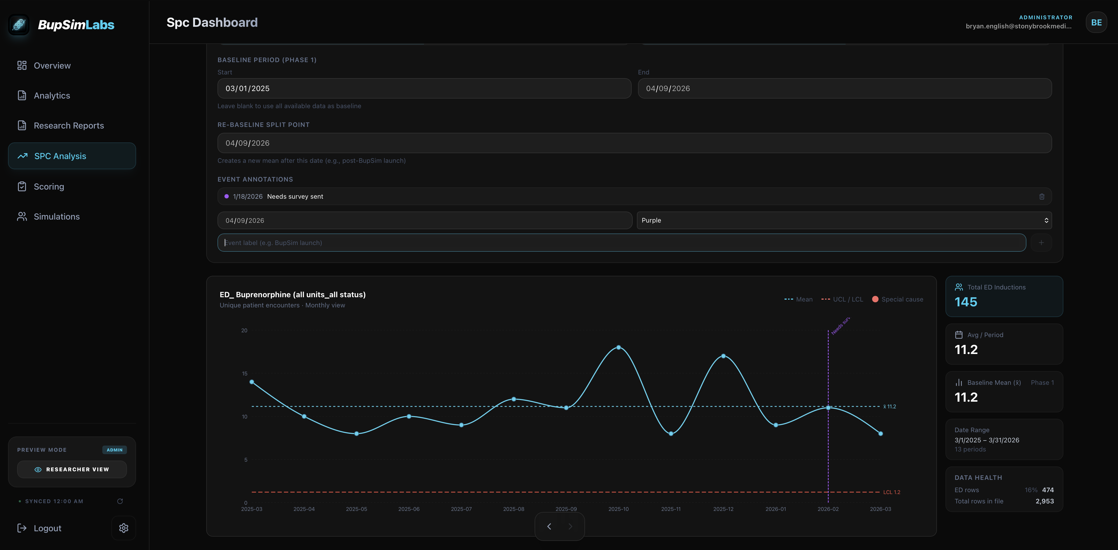

Slide 31
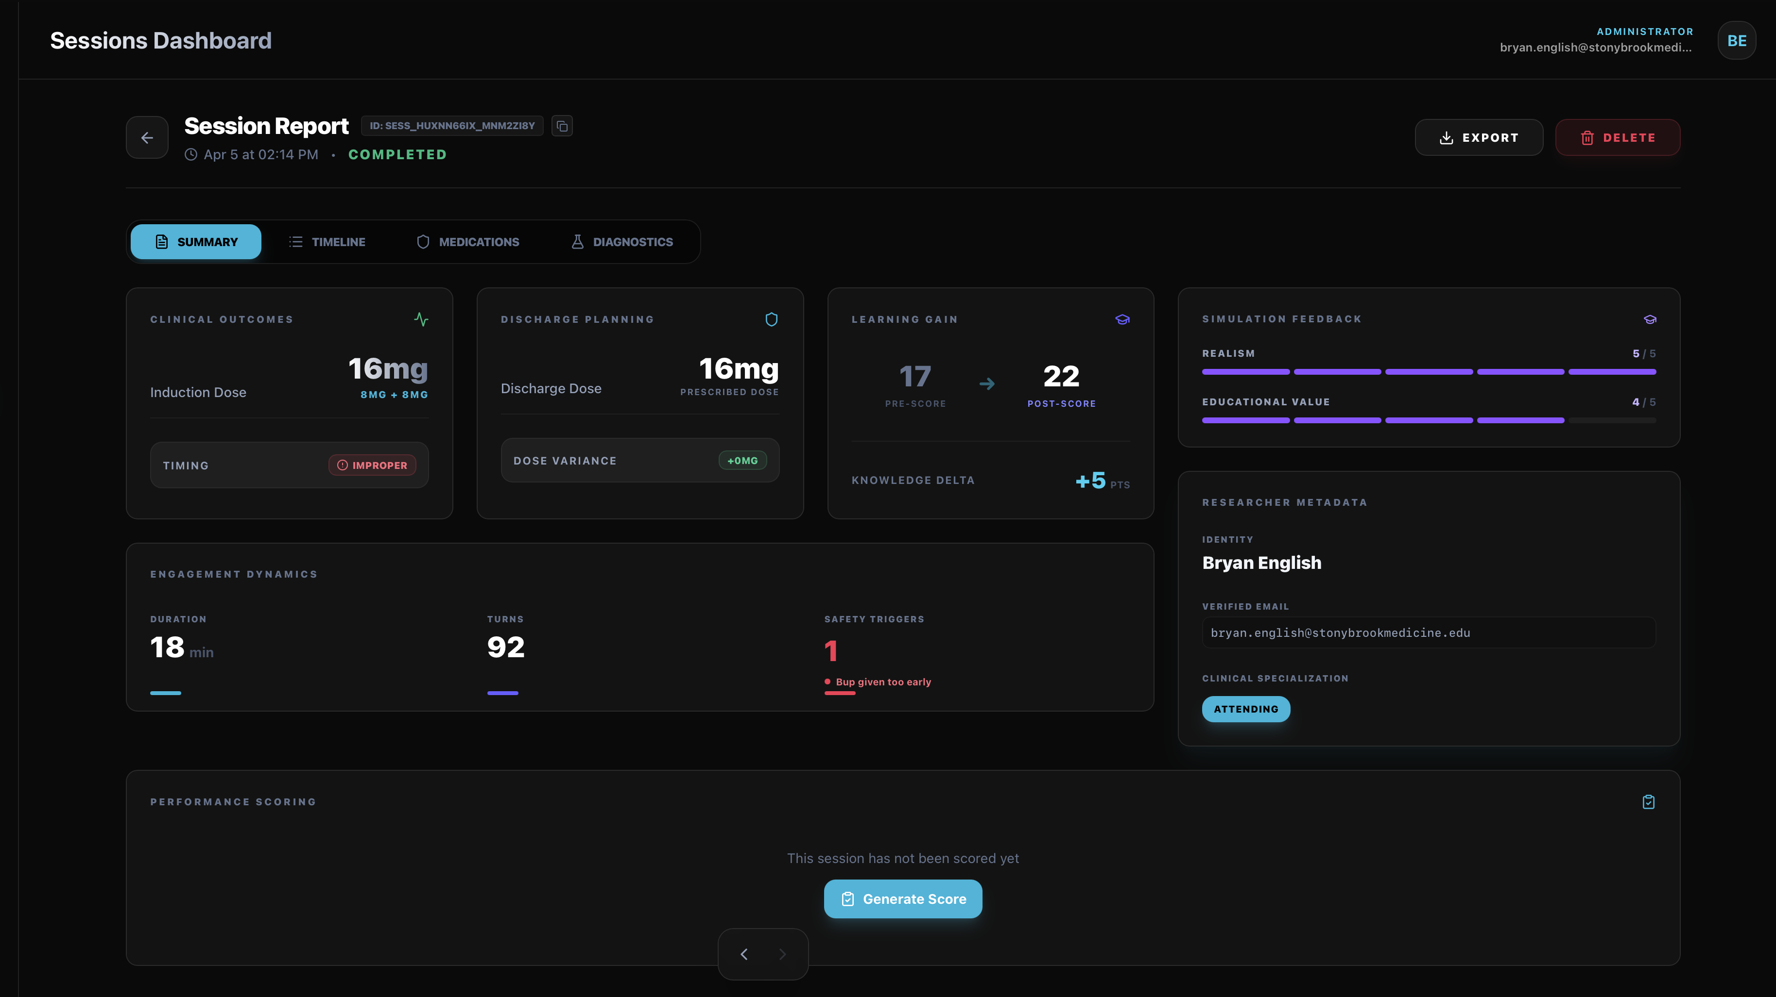

Slide 32
Thank You!
We appreciate your participation!
Simulator Location: Resident Room, Emergency Department
iPad Code: 3-8-8-0
For assistance:
Bryan English, MD bryan.english@stonybrookmedicine.edu
David Paddock, MD david.paddock@stonybrookmedicine.edu

